Slide 1


Ethereum and Crypto Tokens
Smart Contracts, Tokens, DApps
Sevgin Mustafov
Blockchain Developer & Course Developer
Academy School of Blockchain
http://kingsland.academy

Slide 2
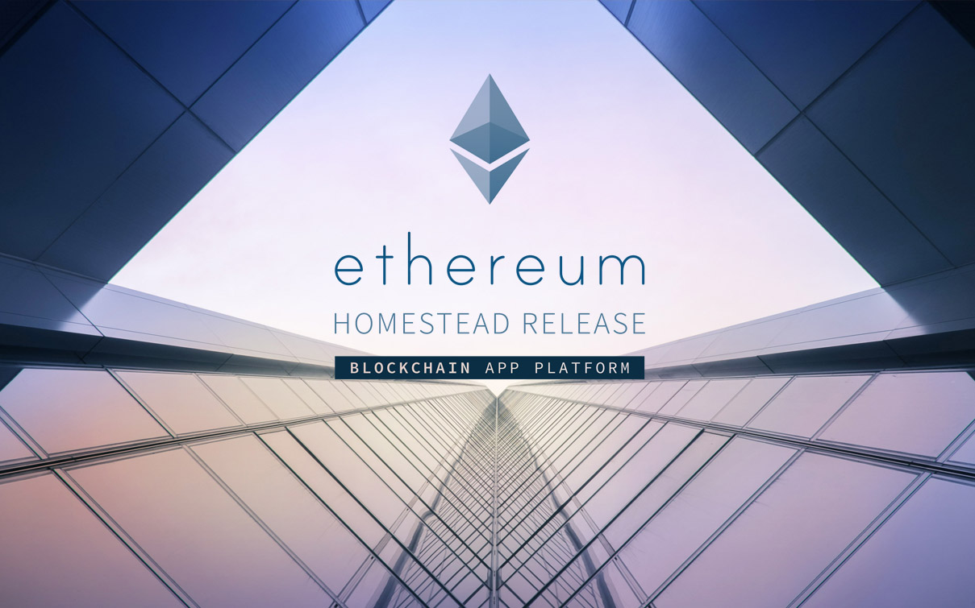

Table of Contents
What is Smart Contract?
How do Smart Contracts Work?
Ethereum Virtual Machine (EVM)
Ethereum Tokens and the ERC-20 Token Standard
Token Sales vs. ICO
What is DAO?
What is Decentralized Application?
Classification of DApps

Slide 3
Ethereum Platform & Smart Contracts
Smart Contracts, Ethereum, EVM

Slide 4

What is Smart Contract?
First mentioned in 1996, Nick Szabo
Help you exchange
Money
Property
Shares
Transparent
Conflict-free
No middleman needed
Define the rules and penalties
Automatically enforce the obligations

Slide 5





How do Smart Contracts Work?
Two blockchain addresses enter into a smart contract
The contract stays in the public ledger
Participants may be anonymous
A triggering event executes the contract code
The contract obligations are enforced (e.g. payments)
Everyone can see the contract activities
All contract data and executed transactions are public on the ledger
Contract actors may be anonymous

Slide 6
Smart Contract Example
pragma solidity ^0.4.18;
contract Greeter {
private string greeting;
function Greeter(string _greeting) public { greeting = _greeting; }
function greet() constant public returns (string) { return greeting; } }
Persistent data stored in the blockchain
Public member function: anyone can invoke it
Public read-only function: does not change the contract state

Slide 7
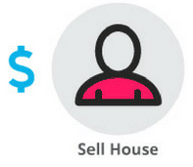
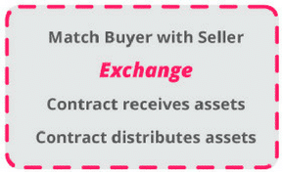
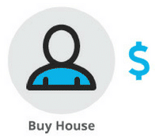

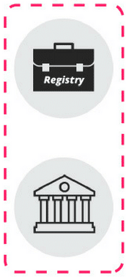
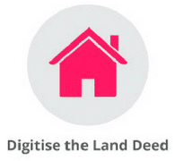

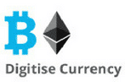
How Should a Smart Contract Work?
Ownership is undisputed
Clearing and settlement is automated

Slide 8

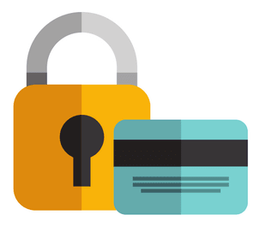
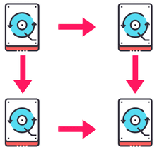
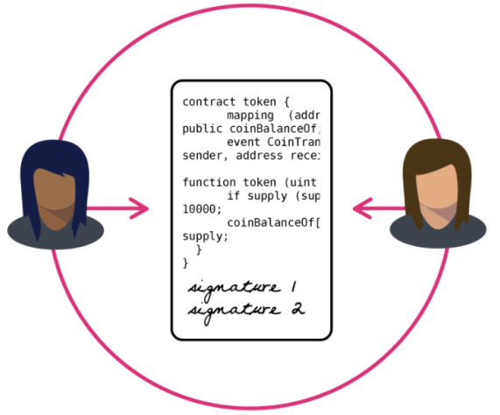
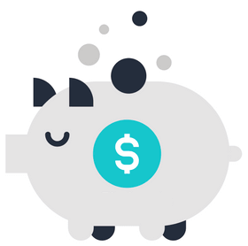
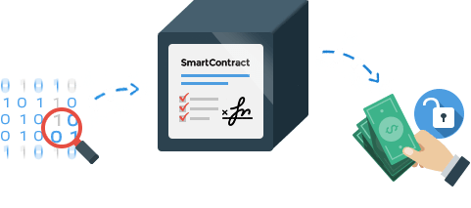

What Smart Contracts Give You?
Autonomy
Backup
Speed
Trust
Savings
Safety
Accuracy

Slide 9
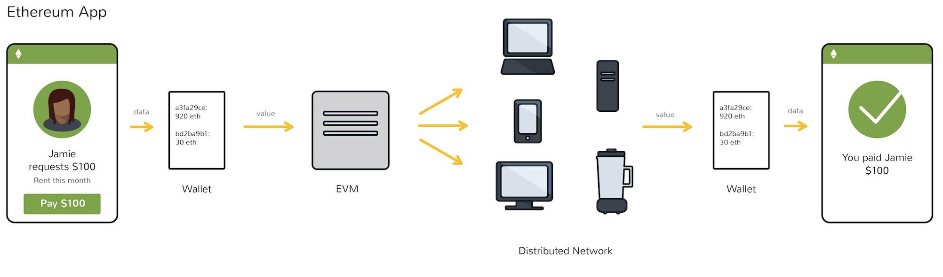
What is the Ethereum Virtual Machine (EVM)?
Ethereum contracts are executed in the EVM
Contract rules are initially programmed
Through a stack-based bytecode language (Solidity)
Are compiled into bytecode

Slide 10
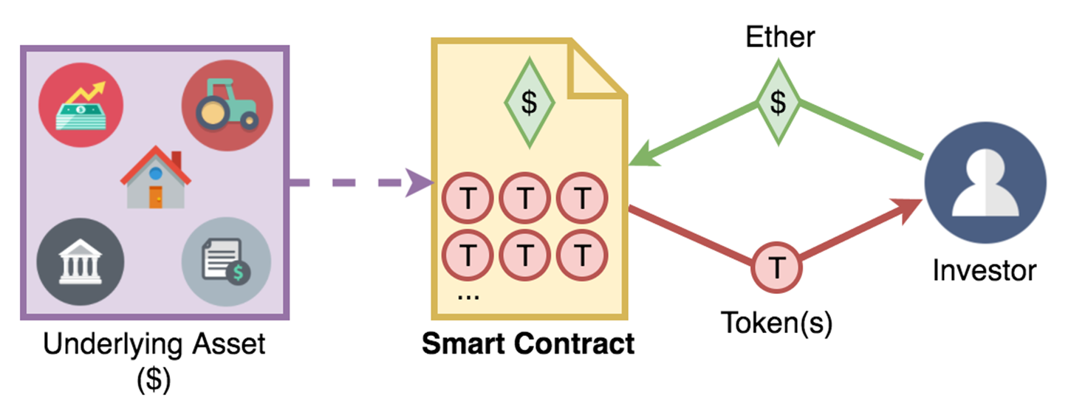
Ethereum Tokens
Tokens, The ERC20 Standard, ICO, DAO

Slide 11
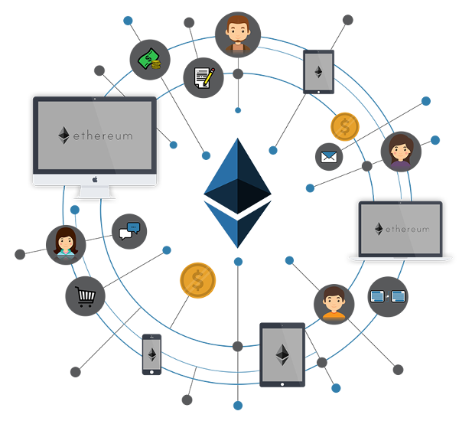
What is Token?
Representation of any fungible tradable good
Sample token use cases:
Virtual currencies
Loyalty points
Game score
The ERC20 token standard allows building tokens
Tradeable at the crypto-exchanges

Slide 12
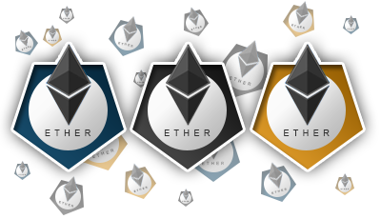

Token Types
Usage tokens
Native currency in DApps
Have monetary value
No particular rights within the network itself
Work tokens
Sort of shareholder in the DApp
E.g. right to vote in a DApp

Slide 13
Simple Token Example
pragma solidity ^0.4.18;
contract MyToken {
mapping (address => uint256) public balanceOf;
function MyToken(uint256 initialSupply) public { balanceOf[msg.sender] = initialSupply; }
function transfer(address _to, uint256 _value) { require(balanceOf[msg.sender] >= _value); require(balanceOf[_to] + value >= balanceOf[_to]); balanceOf[msg.sender] -= _value; balanceOf[_to] += _value; }
}
Map holding all balances
Initialize the contract
Transfer tokens to someone

Slide 14
ERC20 Token Standard Interface
ERC20 – the most used token standard in the Ethereum ecosystem
contract ERC20 {
function totalSupply() → uint
function balanceOf(address _owner) → uint
function transfer(address _to, uint _value) → bool
function transferFrom(address _from, address _to, uint _val) → bool
function approve(address _spender, uint _value) → bool
function allowance(address _owner, address _spender) → uint
event Transfer(address _from, address _to, uint _value)
event Approval(address _owner, address _spender, uint _value)
}
Learn more at https://theethereum.wiki/w/index.php/ERC20_Token_Standard

Slide 15
Token Sale vs. ICO
Initial Coin Offering (ICO)
Distributes coins initially to shareholders
When a new blockchain network is launched
Bitcoin, Ethereum, Zcash, NEM produce “coins”
Often used incorrectly to describe Ethereum token launches
Token Sale Event
Tokens store complex, multi-faceted levels of value
Generated by a smart contract system, distributed or sold to shareholders
E.g. sell ETH for ERC20 tokens
Token economy describes how the tokens are used

Slide 16
Token Economics (Tokenomics)
Modern blockchain startups are funded by token sale events
A token economics stays behind (described in a whitepaper)
Crypto-tokens / coins are distributed between project participants
May serve as payment / to hold stake / to allow voting / etc.
Startups define the token economics themselves
Tokens can be fixed amount or inflational / deflational
Participants can buy / sell / use / get as reward / burn / etc. tokens
Examples: EOS, Tronix (TRON), ICON, LockChain (LOC)

Slide 17
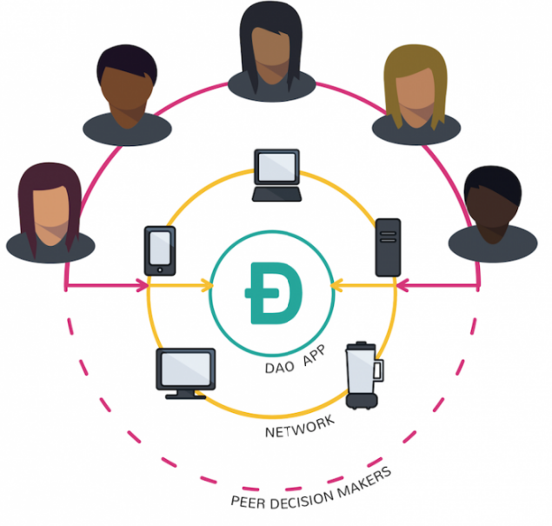
What is DAO?
DAO == Decentralized Autonomous Organization
Smart-contract driven organization, no owner
No human intervention for its operation
Example:
Autonomous flight delay insurance company accepts coins / tokens as insurance premium
If your flight is delayed, it pays back 10 x premium amount
A "decentralized oracle" tells which flights are delayed
“On the Blockchain, no one knows you're a fridge” – Richard Brown

Slide 18

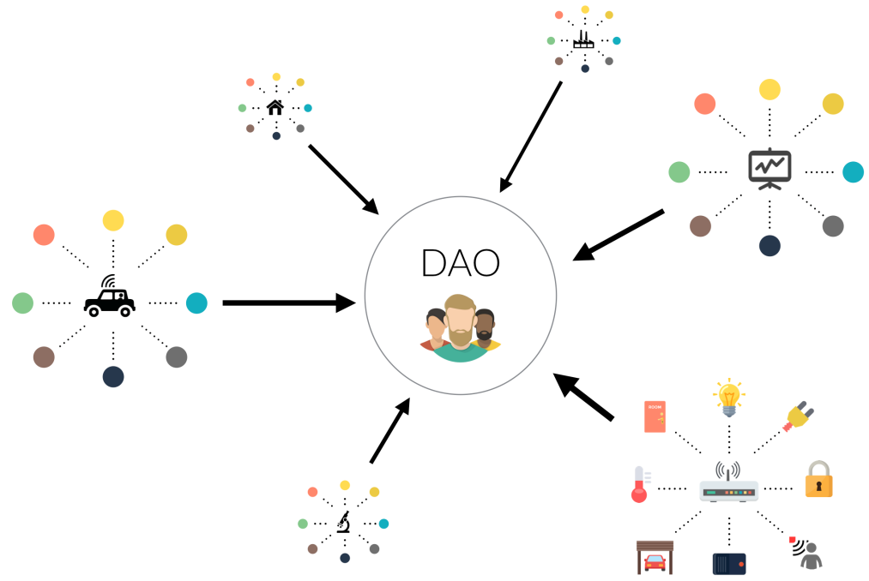
"The DAO" Project is not DAO
"The DAO" Project launched in 2016
The plan
Participants purchase DAO tokens
Vote for which ICO projects to fund
Selected projects get investments
Relied on the “wisdom of crowds”
Enormous smart contract hack caused the Ethereum to hard fork

Slide 19
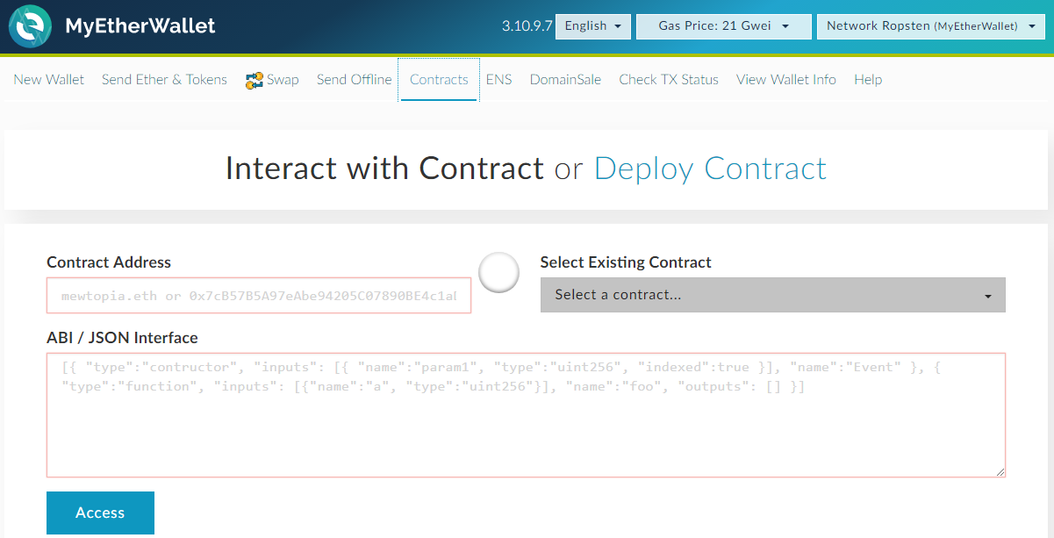
Exercise
Buy and Send ERC20 Tokens

Slide 20
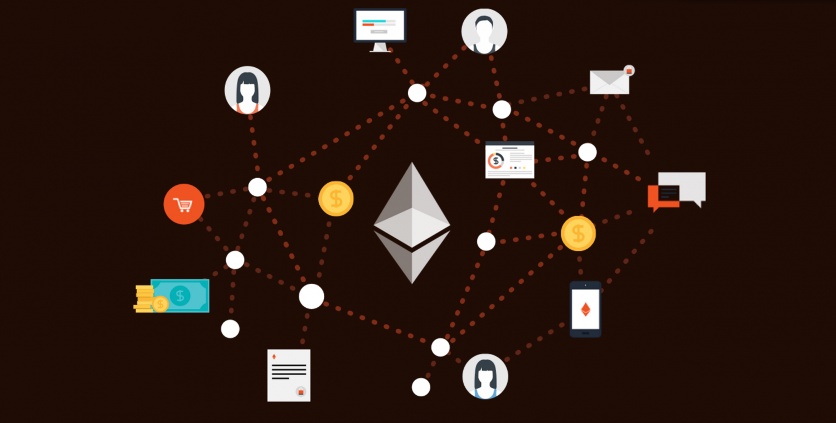
DApps
Overview of DApps

Slide 21
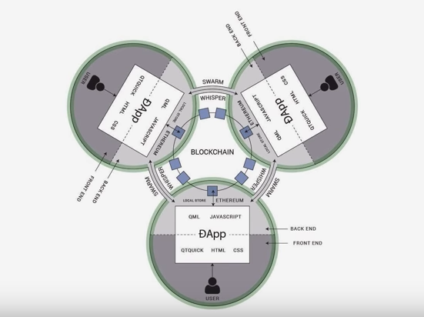
What is Decentralized Application (DApp)?
Run on a P2P network of computers (e.g. on the blockchain)
Data storage and processing should be decentralized
Decentralized
No central point of control
Open source
The code is public & transparent
Incentivized
Users pay / get rewards
Bitcoin – the first DApp

Slide 22
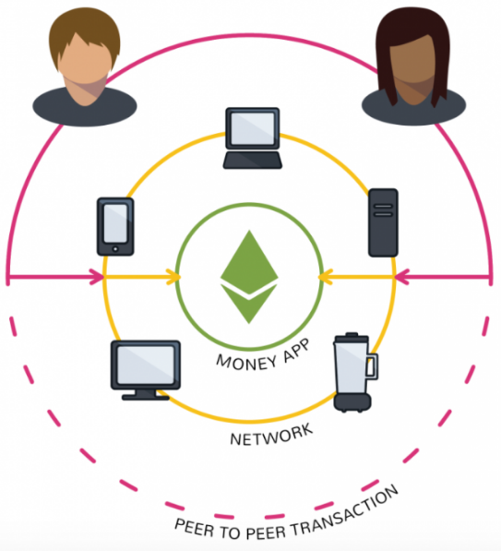
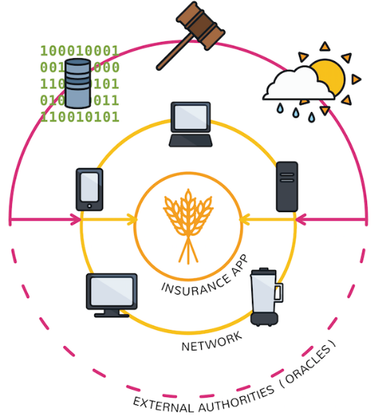
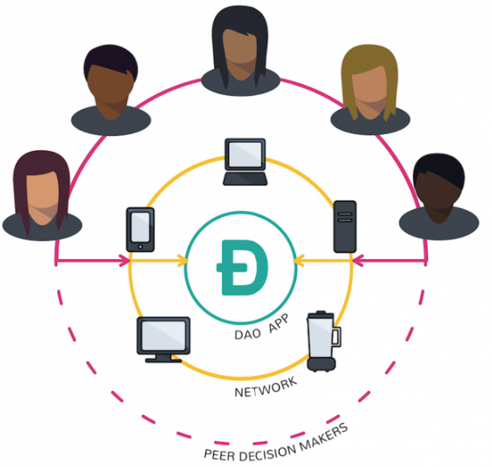
Types of Decentralized Application
Exchange ether / tokens as a way to settle a contract
Mixes money with information from outside the blockchain (with oracles)
Program rules how members can vote to manage company funds

Slide 23
Classification of DApps
Type I
Run their own blockchain network / distributed ledger
Examples:
Bitcoin, Ethereum, Litecoin, Steem, IOTA, Cardano
Type II
Use existing blockchain network
Have tokens
Omni – runs on top of Bitcoin
Golem – runs on top of Ethereum
Type III
Build on top of Type II network / protocol
SAFE Network uses the Omni protocol

Slide 24
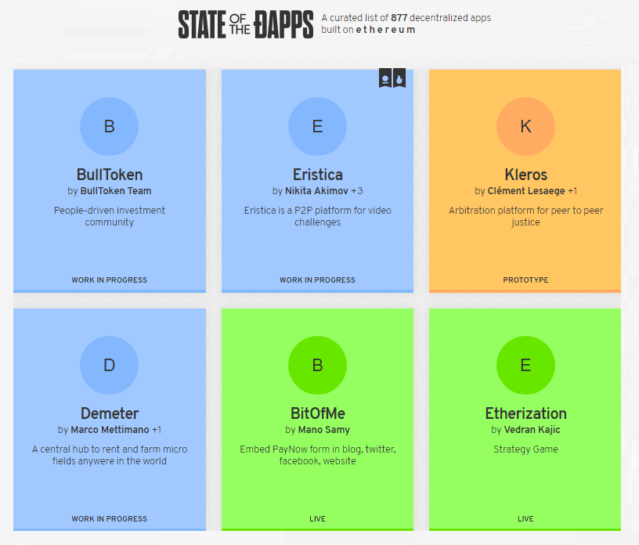
Live Demo
Explore Decentralized Applications
https://stateofthedapps.com

Slide 25
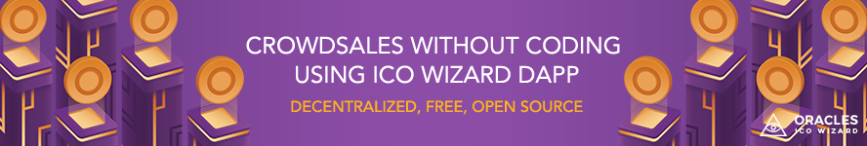
Exercise
Create Crowdsale without Coding
NOT for Serious Projects!

Slide 26

Summary
Smart contract is decentralized computer program intended to facilitate, verify, or enforce a digital negotiation
Program data is stored in a distributed ledger technology (DLT)
Program code is executed in a DLT
Token is representation of any fungible tradable value
ICO often used to describe Ethereum token launches
DAO is autonomous decentralized organization
Decentralized applications (DApps) runs on a P2P network and interact with traditional apps / users

Slide 27
Ethereum and Crypto Tokens
http://www.kingsland.academy

Slide 28
Resources
Smart Contracts: https://blockgeeks.com/guides/smart-contracts/
Token: https://blockgeeks.com/guides/ethereum-token/
DApp: https://www.coindesk.com/information/what-is-a-decentralized-application-dapp/
Token Sale vs. ICO: https://medium.com/@SingularDTV/whats-the-difference-between-an-ico-and-a-token-launch-7105edbb2112
Classification of Dapps: https://github.com/DavidJohnstonCEO/DecentralizedApplications/blob/master/README.md

